Slide 1
FOETAL TO NEONATAL CIRCULATORY TRANSITION
Presented by
Dr. Mahadevi A.L
Assistant professor
Dept of paediatrics.

Slide 2
How does the fetal circulatory system work?
During pregnancy, the unborn baby (fetus) depends on its mother for nourishment and oxygen. Since the fetus doesn’t breathe air, his or her blood circulates differently than it does after birth:
The placenta is the organ that develops and implants in the mother's womb (uterus) during pregnancy. The unborn baby is connected to the placenta by the umbilical cord.
All the necessary nutrition, oxygen, and life support from the mother’s blood goes through the placenta and to the baby through blood vessels in the umbilical cord.
Waste products and carbon dioxide from the baby are sent back through the umbilical cord blood vessels and placenta to the mother's circulation to be eliminated.

Slide 3
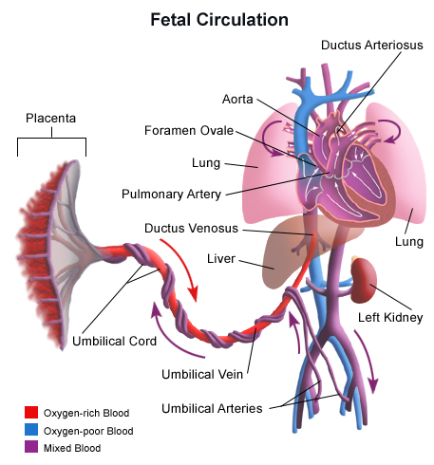

Slide 4
While the baby is still in the uterus, his or her lungs are not being used. The baby’s liver is not fully developed. Circulating blood bypasses the lungs and liver by flowing in different pathways and through special openings called shunts.
Blood flow in the unborn baby follows this pathway:
Oxygen and nutrients from the mother's blood are transferred across the placenta to the fetus through the umbilical cord.
This enriched blood flows through the umbilical vein toward the baby’s liver. There it moves through a shunt called the ductus venosus.
This allows some of the blood to go to the liver. But most of this highly oxygenated blood flows to a large vessel called the inferior vena cava and then into the right atrium of the heart.

Slide 5
Here is what happens inside the fetal heart:
When oxygenated blood from the mother enters the right side of the heart it flows into the upper chamber (the right atrium). Most of the blood flows across to the left atrium through a shunt called the foramen ovale.
From the left atrium, blood moves down into the lower chamber of the heart (the left ventricle). It's then pumped into the first part of the large artery coming from the heart (the ascending aorta).
From the aorta, the oxygen-rich blood is sent to the brain and to the heart muscle itself. Blood is also sent to the lower body.

Slide 6
Blood returning to the heart from the fetal body contains carbon dioxide and waste products as it enters the right atrium. It flows down into the right ventricle, where it normally would be sent to the lungs to be oxygenated. Instead, it bypasses the lungs and flows through the ductus arteriosus into the descending aorta, which connects to the umbilical arteries. From there, blood flows back into the placenta. There the carbon dioxide and waste products are released into the mother's circulatory system. Oxygen and nutrients from the mother's blood are transferred across the placenta. Then the cycle starts again.

Slide 7
At birth, major changes take place. The umbilical cord is clamped and the baby no longer receives oxygen and nutrients from the mother. With the first breaths of air, the lungs start to expand, and the ductus arteriosus and the foramen ovale both close. The baby's circulation and blood flow through the heart now function like an adult's.

Slide 8
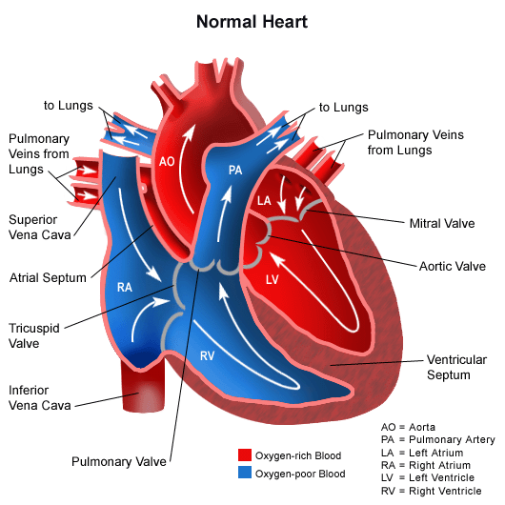

Slide 9
The transition from fetal to neonatal life requires complex physiological changes that must occur in a relatively short period of time.
The fetus must move from reliance on the maternal heart, lungs, metabolic and thermal systems to being able to self-sufficiently deliver oxygenated blood to the tissues and regulate various body processes.
While the majority of critical transitions occur in the first few moments after birth, circulatory and pulmonary changes continue for up to 6 weeks after birth. Transition is a time of significant risk to the newborn and necessitates astute observations on the part of the healthcare team.

Slide 10
PHYSIOLOGY OF TRANSITION Cardiovascular changes
Fetal circulation is characterized by the presence of three shunts, the ductus venosus, ductus arteriosus and foramen ovale, as well as high pulmonary vascular resistance (PVR) resulting from the relative hypoxic pulmonary environment (pO₂ 17-19 mmHg) and low systemic vascular resistance (SVR) .
To fully appreciate the hemodynamic changes which occur after birth, a review of fetal circulation is necessary.

Slide 11
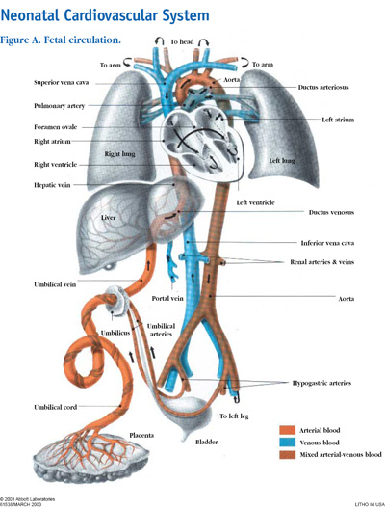

Slide 12
In utero, oxygenated blood is delivered from the placenta to the fetus through the umbilical vein and into the liver.
Some of this blood perfuses the liver, while the rest of the blood bypasses the hepatic system through the first fetal shunt, the ductus venosus, which forms a connection between the umbilical vein and the inferior vena cava (IVC).
The percentage of blood directed towards the liver increases with increasing gestational age with about 80 % entering the liver by 32 weeks' gestation [3,14,15].
In the IVC oxygenated blood from the ductus venosus mixes with unoxygenated blood from the lower body although the oxygenated blood, which has a higher level of kinetic energy, tends to remain in a relatively separate stream.

Slide 13
When the stream of oxygenated blood enters the right atrium, about 50-60 % is directed through the foramen ovale to the left atrium by the Eustatian valve (a flap of tissue at the IVC right-atrium junction) .
The foramen ovale is also a flaplike structure between the right and left atria that acts like a one-way valve. Blood flows across the foramen ovale because high pulmonary vascular resistance maintains pressure in the right atrium at a level greater than that of the left atrium.
The superior vena cava drains deoxygenated blood from the head and upper extremities into the right atrium, where it mixes with oxygenated blood from the placenta

Slide 14
This blood enters the right ventricle and pulmonary artery where, again, increased resistance in the pulmonary vessels causes 90 % of this blood to be shunted across the ductus arteriosus and into the aorta. This mixture of oxygenated and deoxygenated blood continues through the descending aorta and eventually drains back to the placenta through the umbilical arteries.
The remaining 10 % the blood coming from the right ventricle perfuses the lung tissue to meet metabolic needs. The blood that actually reaches the lungs represents about 8 % of the fetal cardiac output [10,4]. After 30 weeks of gestation the amount of blood perfusing the lungs gradually increases in preparation for birth .

Slide 15
During fetal life, the placenta is an organ of low vascular resistance. Clamping the umbilical cord at birth eliminates the placenta as a reservoir for blood, causing a rise in blood pressure and SVR.
As oxygen enters the lungs, the pulmonary vascular bed dilates, increasing blood flow to the lungs and causing pressure in the right atrium to fall. The increased pulmonary venous return to the left atrium and less blood flow into the right atrium cause the left atrial pressure to exceed the pressure in the right atrium, resulting in functional closure of the foramen ovale.

Slide 16
After closure, blood is directed from the right atrium to the right ventricle and on to the lungs rather than through the foramen ovale.
Shunting of blood from the pulmonary artery through the ductus arteriosus to the aorta occurs as a result of high PVR. After birth, SVR rises and PVR falls, causing a reversal of blood flow through the ductus and an 8-10 fold increase in pulmonary blood flow .
In utero, patency of the ductus arteriosus is maintained by high levels of prostaglandins and the low fetal pO₂. Prostaglandins are secreted by the placenta and metabolized in the lungs.

Slide 17
Smaller volumes of blood passing through the fetal lungs result in elevated circulating prostaglandin levels which fall after birth as more blood flows to the lungs. The major contributing factor to closure of the ductus arteriosus is sensitivity to rising arterial oxygen concentrations in the blood . As the pO₂(aB) level increases after birth, the ductus arteriosus begins to constrict.
Removal of the placenta decreases prostaglandin levels, further influencing closure .

Slide 18
Constriction of the ductus arteriosus is a gradual process, permitting bidirectional shunting of blood after birth. PVR may be higher than the SVR, allowing some degree of right-to-left shunting, until the SVR rises above PVR and blood flow is directed left to right.
Most neonates have a patent ductus arteriosus in the first 8 hours of life with spontaneous closure occurring in 42 % at 24 hours of age, in 90 % at 48 hours of age and in almost all infants at 96 hours .
Permanent anatomic closure of the ductus arteriosus occurs within 3 weeks to 3 months after birth.

Slide 19
Prior to birth the pulmonary blood vessels have a thick layer of smooth muscle, which plays a key role in pulmonary vasoconstriction. After birth this muscle layer becomes less sensitive to changes in oxygenation and begins to thin, a process which continues for 6-8 weeks .
Any clinical situation that causes hypoxia, with pulmonary vasoconstriction and subsequent increased PVR, potentiates right-to-left shunting across the ductus arteriosus and foramen ovale .

Slide 20
When the umbilical cord is clamped, blood flow through the umbilical vein to the ductus venosus ceases. Systemic venous blood flow is then directed through the portal system for hepatic circulation. Umbilical vessels constrict, with functional closure occurring immediately. Fibrous infiltration leads to anatomic closure in the first week of life in term infants.

Slide 21
Respiratory adaptations
At birth the clamping of the umbilical cord signals the end of the flow of oxygenated blood from the placenta. To establish effective ventilation and tissue oxygenation, the neonate must clear the lungs of fetal lung fluid, establish a regular pattern of breathing and match pulmonary perfusion to ventilation.
Other factors, including pulmonary blood flow, surfactant production and respiratory musculature also influence respiratory adaptation to extrauterine life.
In utero, the lung epithelium secretes fluid, a process which is essential to the normal growth and development of the alveoli . Toward the end of gestation, the production of lung fluid gradually diminishes and absorption of fluid begins.

Slide 22
The catecholamine surge that occurs just before the onset of labor has also been shown to correspond to a more rapid drop in fetal lung fluid levels. Those infants who do not experience labor, such as those born by elective cesarean section, are more likely to have residual fluid in the lungs and develop Transient Tachypnea of the Newborn (TTN) because of lower levels of serum catecholamine.

Slide 23
Initiation of breathing is a complex process that involves the interplay of biochemical, neural and mechanical factors, some of which have yet to be clearly identified.
A number of factors have been implicated in the initiation of postnatal breathing: decreased oxygen concentration, increased carbon dioxide concentration and a decrease in pH, all of which may stimulate fetal aortic and carotid chemoreceptors, triggering the respiratory center in the medulla to initiate respiration.

Slide 24
Some researchers have questioned the influence of these factors and suggest instead that factors secreted by the placenta may inhibit breathing, and that regular breathing is initiated with the clamping of the cord [1].
Mechanical compression of the chest creates negative pressure and drawing air into the lungs as the lungs re-expand. Further expansion and distribution of air throughout the alveoli occur when the newborn cries.
Crying creates a positive intrathoracic pressure that keeps alveoli open and forces the remaining fetal lung fluid into pulmonary capillaries and the lymphatic circulation.

Slide 25
NORMAL TRANSITIONAL FINDINGS
Much of the work of transition is accomplished in the first 4-6 hours following delivery, while final completion of the cardiovascular changes may take up to 6 weeks .
During the initial hours after birth, the majority of fetal lung fluid is reabsorbed, a normal functional residual capacity is established in the lungs and the cardiovascular system redistributes blood flow to the lungs and tissues. The infant moves through a fairly predicable series of events mediated by the sympathetic nervous system that results in changes in heart rate, respirations, gastrointestinal function and body temperature.

Slide 26
In a classic description still used today, Desmond and colleagues organized these changes into three stages:
The first period of reactivity (0-30 minutes) characterized by an increase in heart rate, irregular respirations and fine crackles in the chest with grunting and nasal flaring
A period of decreased responsiveness (30 minutes to 3 hours) with rapid shallow respirations, lower heart rate, decreased muscle activity interspersed with jerks and twitches and sleep
A second period of reactivity (2-8 hours) in which exaggerated responsiveness, tachycardia, labile heart rate, abrupt changes in tone and color, and gagging and vomiting are commonly seen.

Slide 27
Thank u

